Slide 1

Capstone Project Hotel Booking Analysis
Cohort – Milan
Team members
Megha Dethe
Praful Gedam

Slide 2
INDEX:
Topic Discussion
Work Flow
Data Collection and Understanding
Data Cleaning and Manipulation
Removing outliers
Correlation heat map
Exploratory Data Analysis
General Question
Hotel Related Analysis
Distribution Wise Analysis
Time Related Analysis
Conclusion

Slide 3
TOPIC DISCUSSION:
For this project we will be analyzing Hotel Booking data. This data set contains booking information for a city hotel and a resort hotel and includes information such as when the booking was made, length of stay, the number of adults, children, and/or babies, and the number of available parking spaces.
Hotel industry is a very volatile industry and the bookings depend on the above factors and many more.
The main objective behind this project is to explore and analyze data to discover important factors that govern the bookings and give insights to hotel management, which can perform various campaigns to boost the business and performance.

Slide 4
Work Flow :
we will divide our work flow into following 3 steps
EDA will be divided into the following 3 analyses. ( We have covered all 3 types in 22 Questions in collab)
1) Univariate analysis: Univariate analysis is the simplest of the three analyses where the data you are analyzing is only one variable.
2) Bivariate analysis: Bivariate analysis is where you are comparing two variables to study their relationships.
3) Multivariate analysis: Multivariate analysis is similar to Bivariate analysis but you are comparing more than two variables.
Data Collection and Understanding
Data Cleaning and Manipulation
Exploratory Data Analysis(EDA)

Slide 5
Data Collection and Understanding:
Market_segment : Market segment designation (TA/TO)
Distribution_channel : Booking distribution channel.(T/A/TO)
Is_repeated_guest : is a repeated guest (1) or not (0)
Previous_cancellations : Number of previous bookings that were canceled by the customer prior to the current booking
Previous_bookings_not_canceled : Number of previous bookings not canceled by the customer prior to the current booking
Reserved_room_type : Code of room type reserved.
Assigned_room_type : Code for the type of room assigned to the booking.
Booking_changes : Number of changes made to the booking from the moment the booking was entered on the ➢
PMS until the moment of check-in or cancellation
Deposit_type : No Deposit, Non-Refund, Refundable.
Agent : ID of the travel agency that made the booking
Company : ID of the company/entity that made the booking.
days_in_waiting_list : Number of days the booking was on the waiting list before it was confirmed to the customer
Customer_type : type of customer. Contract,Group,transient,Transient party.
Adr : Average Daily Rate as defined by dividing the sum of all lodging transactions by the total number of staying nights.
Reuired_car_parking_spaces : Number of car parking spaces required by the customer.
Total_of_special_requests : Number of special requests made by the customer (e.g. twin bed or high floor)
Reservation_status : Reservation last status.

Slide 6
Data Collection and Understanding:
After collecting data it’s very important to understand your data. So we had hotel Booking analysis data. Which had 119390 rows and 32 columns. So let’s understand these 32 columns.
Data Description:
Hotel :Resort Hotel or City Hotel
Is_canceled : Value indicating if the booking was canceled (1) or not (0)
Lead_time : Number of days that elapsed between the entering date of the booking and the arrival date.
Arrival_date_year : Year of arrival date.
Arrival_date_month : Month of arrival date.
Arrival_date_week_number : Week number of year for arrival date.
Arrival_date_day_of_month : Day of arrival date.
Stays_in_weekend_nights : Number of weekend nights.
Stays_in_week_nights : Number of weeknights.
Adults : Number of adults.
Children : Number of children.
Babies : Number of babies.
Meal : Type of meal booked.
Country : Country of origin

Slide 7
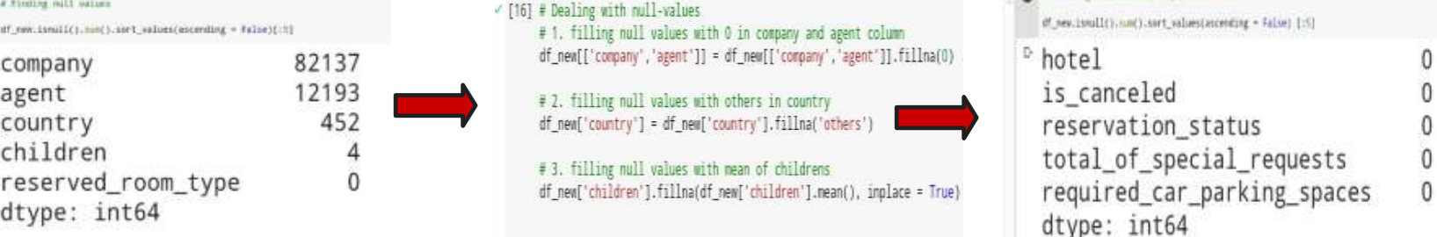
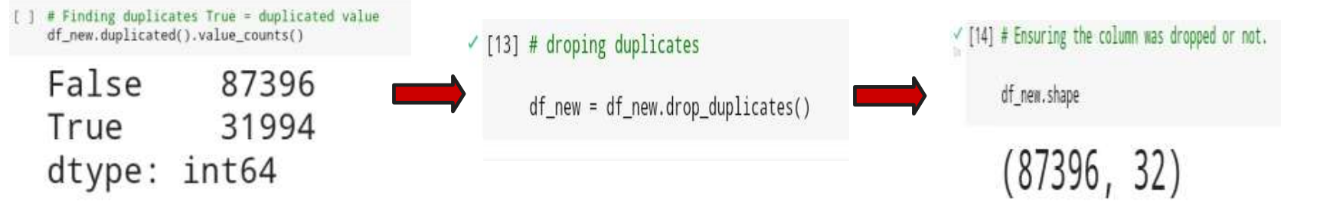
Data Cleaning and Manipulation:
There were 4 columns company, agent, country, and children with null values changing the value.
Handling Duplicates: Data had 31994 duplicate values. So we dropped it from the data

Slide 8

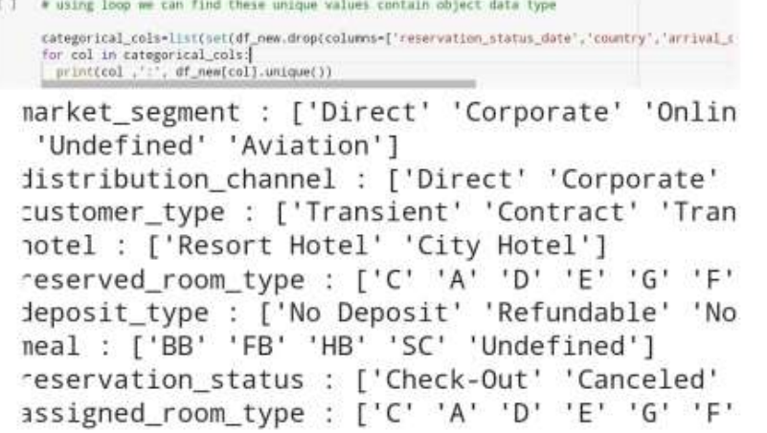
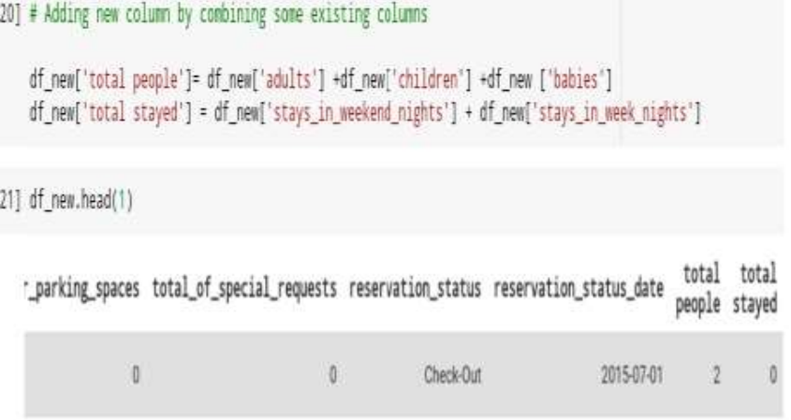
Data Cleaning and Manipulation:
We created 2 new columns
1)‘Total People’ = from the Children, adults, and
babies.
2) ‘Total stayed’ = From weekend nights and
weekdays night
We saved columns containing object data type in a
variable named categorical_cols by subtracting
numerical columns I.e. set(df.describe()) on that we
used For loop to iterate these values and we get
unique values

Slide 9
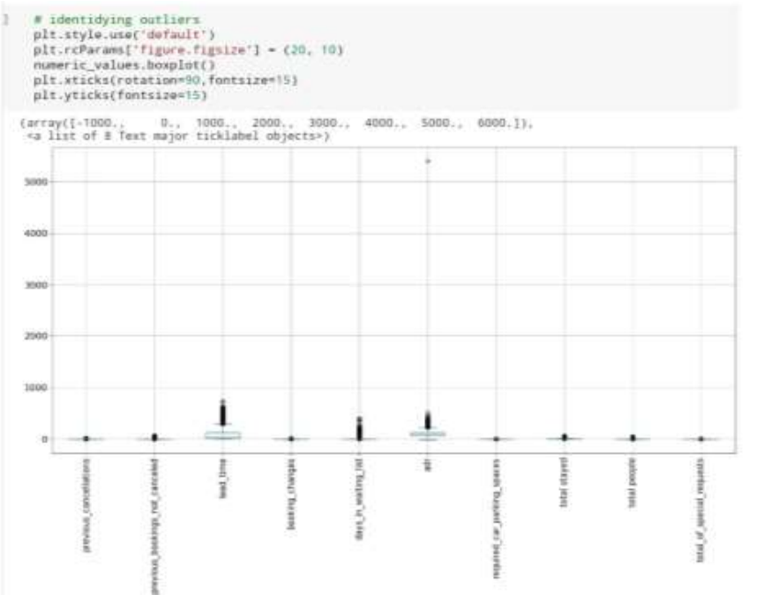
Finding and removing outliers:
We found the outlier by applying a box plot to it. Although it is a manual method, In this case, we found only one
outlier in a dataset that’s why we used the manual method after this we dropped the outlier values but if there
were more outliers we can use IQR or Z score method it is more preferred methods and gives accurate outliers.

Slide 10
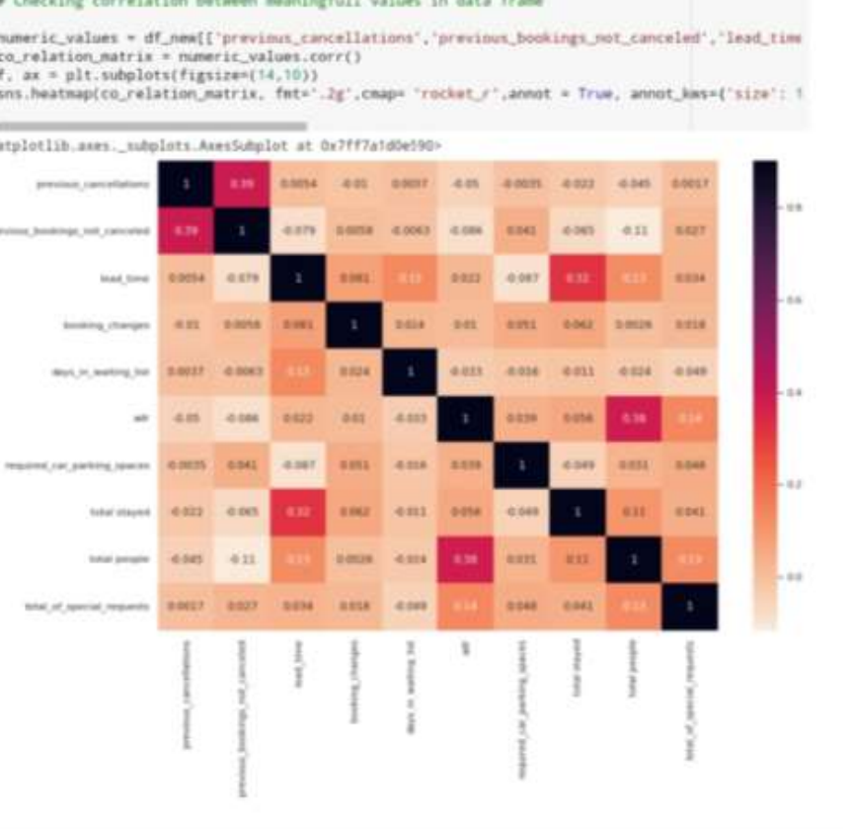
Co-relation and Heatmap:
For longer duration of stays people generally plan little before the actual arrival.
Around 13% of total people have made a
special request in their booking.
Barely any transaction has
occurred which led to the cancellation
afterward.

Slide 11
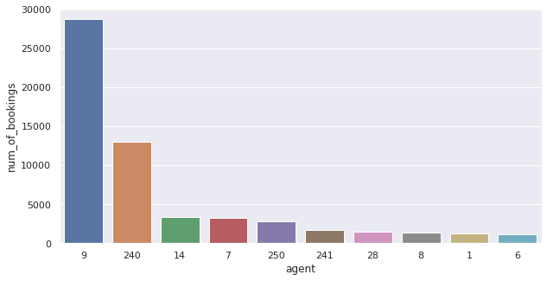
EDA [Exploratory Data Analysis]
1. Which Agent makes most no. of bookings
Observation
Agent no.9 makes most of the
bookings

Slide 12
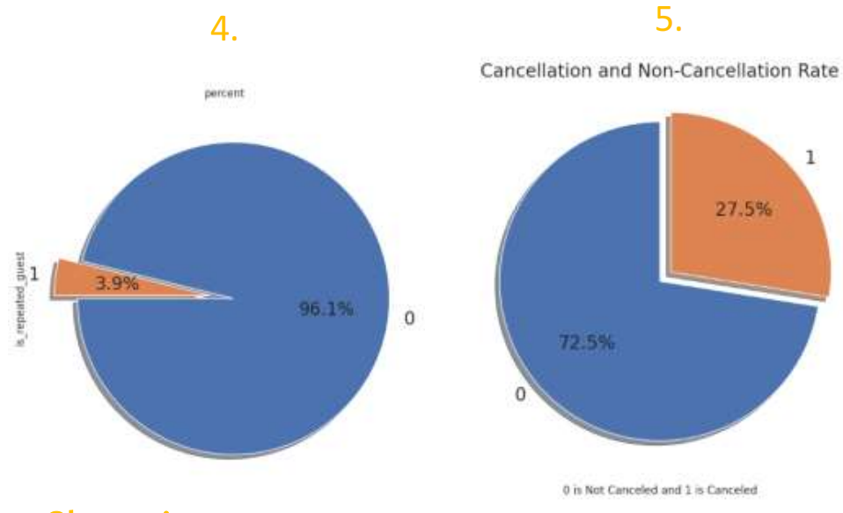
Distribution-related analysis:
2. Hotel cancelation rate
Observation
27.5% of people canceled their booking. We have to find out the reasons why these people canceled their bookings. Also, feedback
can be taken from guests who cancel their bookings.

Slide 13
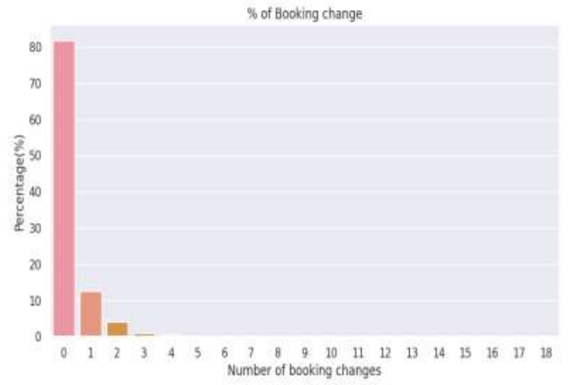
Distribution-related analysis
3. Which Percentage of Booking changes made by the customer.
Observation
Almost 82% of the bookings were not changed by guests

Slide 14
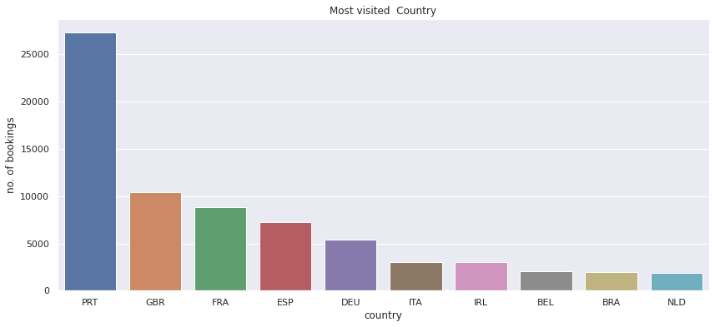
Data Analysis:
4. From which country, guest visited the most.
Observation
most of the guest are coming in portugal more than 40000

Slide 15
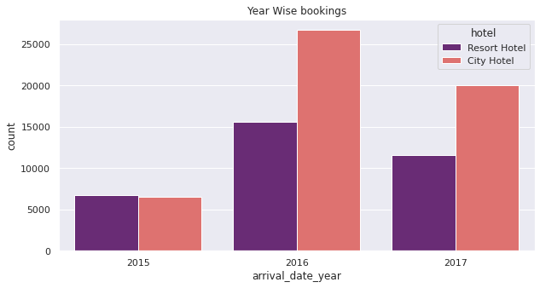
Time related analysis:
5. Which year had the highest bookings?
Observation :
1. Year wise booking count :
⮚ 2015 had less than 7000 bookings.
⮚ 2016 had the highest bookings.
⮚ Overall, City Hotels had the most of the bookings

Slide 16
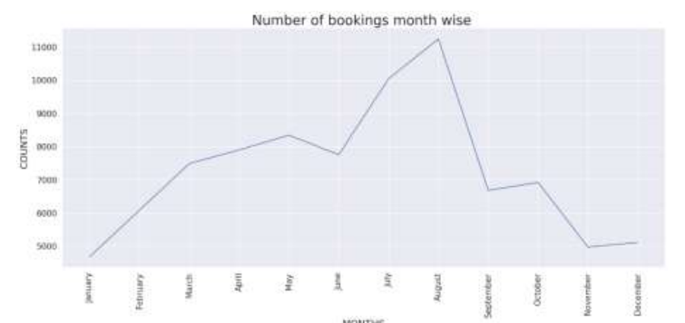
6. In which month most of the bookings happened?
Observation
July and August months had the most Bookings. Summer vacation can be the reason for the bookings

Slide 17
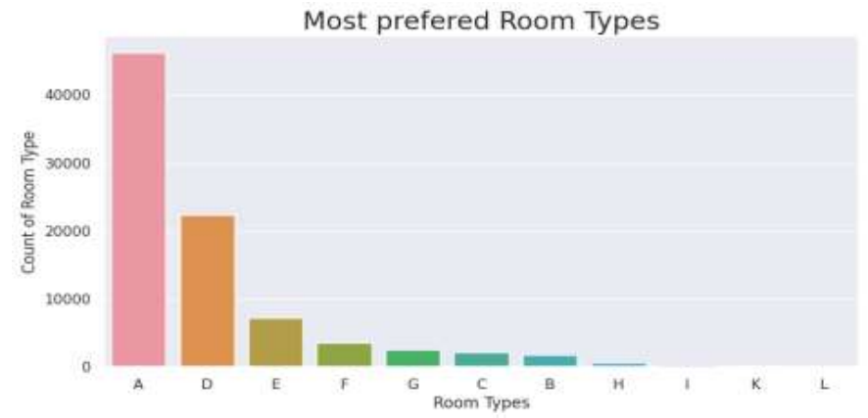
7. Most preferred room type by the customers
Observation :
❖ Most preferred room type is A by
customers

Slide 18
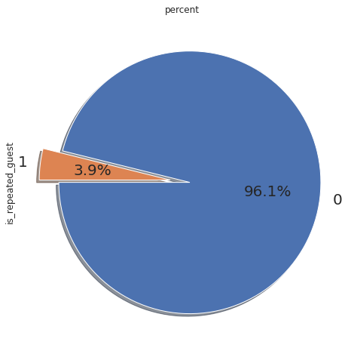
8. count of repeated guest?
Observation:
Repeated guests are very few which only 3.9 %.* In order to retain the guests, management should take feedbacks from guests and try to improve the services.

Slide 19

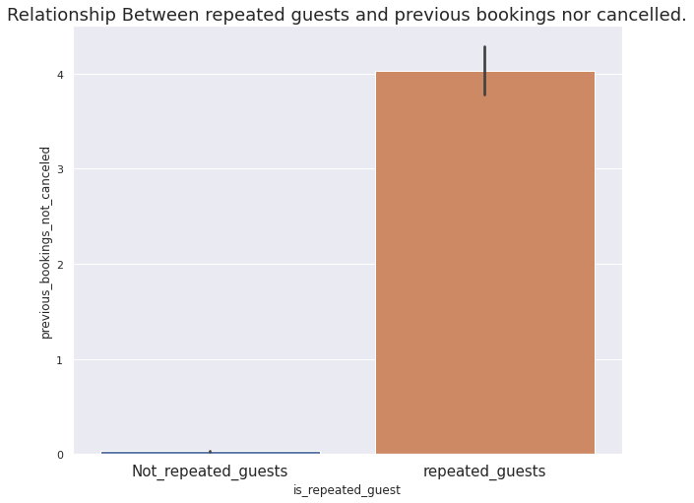
9. Relationship between the repeated guests and previous bookings not cancelled?
Observation :
Not Repeated guests are more likely to cancel their bookings.

Slide 20
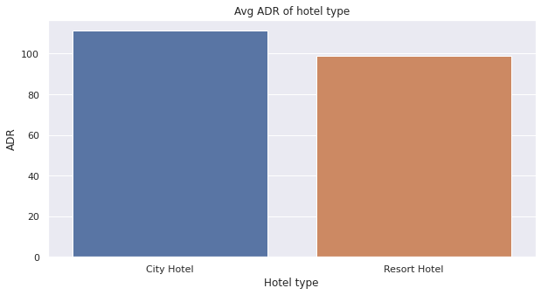
10. Which Hotel type has the highest ADR?
Observation
City Hotel has the highest ADR. This means City Hotels are generating more revenue than the resort hotels. More the ADR, more is the revenue.

Slide 21
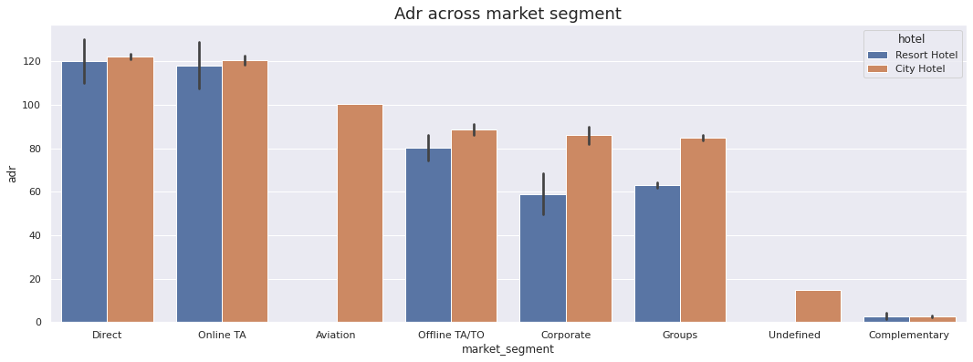
11. ADR across different market segment
Obseravtion :
'Direct' and 'Online TA' are contributing the most in both types of hotels.* Aviation segment should focus on increasing the bookings of 'City Hotel'

Slide 22

Conclusion
Based on the above observation, we concluded that this capstone project on “Hotel
Booking Analysis”
It helps a hotel in up scaling their business by improving their techniques, technologies,
and many small requirements which guests required during their stay in this hotel.
❖ It also helps people to understand how things work in real life and the need &
importance of data science in the real world.
❖ It helps increase in efficiency and effectiveness of various methods or processes
involved in the hotel booking system.
❖ It increases the competition and productivity among various hotels to provide a better
facility and comfort that the customer needed.

Slide 23
Thank You

